Slide 1
HoneyDew
Application Project
I’m developing a project for MSSA CAD Cohort. The application enables a Primary user to be able to:
Set up an account with user name, password. This requires basic information such as email address, first and last name.
Requirements
Able to link a major brand store application such as Walmart.
Primary and secondary user are able to Create, Read, Update and Delete the information of the application.
Primary user will be the admin of the application.
Primary and secondary are able to perform and assign the following:
Create, update and delete a grocery list.
Create, update and delete a chores list.
Create, update and delete upcoming reminders.
Assign additional members to the account.
Assign specific tasks to members in chore list.
H
d
d

Slide 2
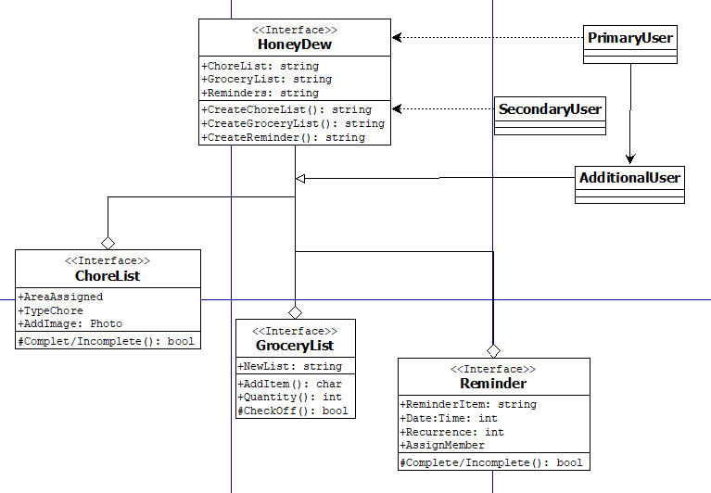
HoneyDew
Application Class Diagram
d

Slide 3
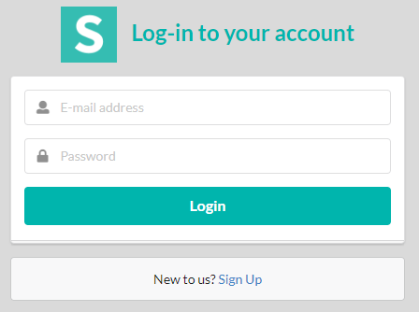
HoneyDew
Main page
Basic main page set up has the following functions:
Email/username and password log in
Able to sign up for new users
d

Slide 4
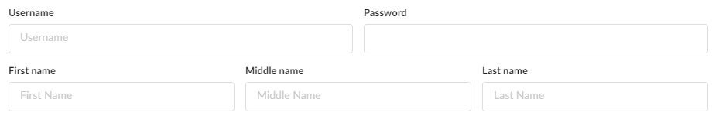
H
Registration
Users registers with basic information. Username, email, password, first and last name. Middle name is optional
Users are able to link their external account to the application.
Link a major brand grocery store application such as Walmart.
Linking an external will enable the following:
Use the accounts store layout (if available).
Find the location of a certain item.
Able to reorganize the shopping list for ease of shopping..
d
External Account
userID
App Accnt #
App Password
App Name
d

Slide 5
H
Additional Members
Basic information required for additional members.
This will enable the primary and secondary account user to assign tasks to members.
Members are able to read information and updates tasks as it is completed.
As tasks are completed and updated. The application will send and automatic update to the primary and secondary users.
d
Additional Member
First Name
Last Name
userID
password
Additional Member
First Name
Last Name
userID
password
Additional Member
First Name
Last Name
userID
password

Slide 6
H
Functions
Upon completion of the main set up of the web application.
The basic display set up is provided.
Main function are grocery list, chores and reminders.
Primary and Secondary users are able to create, read, update and delete lists as required on all three functions.
Additional members are able to read and update information as they are tasked.
d
Grocery List
Chores
Reminders

Slide 7
H
Grocery List Function
Automatically synced with linked external accounts.
Will be reorganized when list is completed according the external account store layout.
When synced, this will reorganized the created list to the store’s specific layout.
This provide ease of shopping when the user enters the store for more direct flow of picking items.
As users pick up each item on the list. It will be check off by the user and automatically updates each member.
Updates will be pushed to all members of the account.
d
Grocery List
Item | Dty | Location
Eggs | 1 | J2
Milk | 1 | A4
Cereal | 1 | B3
Update all
Sync Acct

Slide 8
H
Chores List Function
Chores are assigned to any members in the account
As chores are assigned, automatic updates will be sent to all members.
Frequency can be assigned either daily, weekly or monthly
Members are able to provide feed back either through application text message, photo.
Assigner can send reminders for a specific task.
d
Chore List
Assigned to:
Big Brother
Current tasks:
Make bed
Take out trash
Sweep living room
Daily
Weekly
Monthly
Update

Slide 9
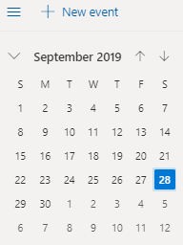
H
Reminder List Function
Set reminders.
Notify all members in the account.
Sync with personal device phone calendar.
Provide reminders to all user or specify who will get reminders.
Able to set up recurring reminders.
Assign reminder to specific members.
d
Reminders
Feed dog
Meeting at work
Pick up dry cleaner
PTA meeting
etc
Add Reminder
Assign Reminder
Sync with Alexa

Slide 10
Application set up
Basic application set up interface for a mobile device.
Three basic lists that will link to next function of the specific list.
The functions of application project will be mainly used on a personal device rather than a computer or laptop.
HoneyDew
List
Shopping
Chores
Reminder
H
d

Slide 11
Grocery List
Basic mobile device layout of the grocery list function.
Primary or secondary user are able to add any member to the specific list who are able to view and update the list.
Link button is provided to sync the list with the specific store.
Grocery
List
Jalapeno
Milk
Eggs
Bacon
Orange Juice
Steak
Chicken
Etc…..
Linked to WalMart (OrangePark)
Add Member
Random Ad
H
d

Slide 12
Reminder List
Primary or secondary user are able to add reminders and assign to any member.
Sync the list with the mobile device calendar choosing.
Upcoming Reminders
Reminder:
Pick up suit/Location/Time
Bring things to work
PTA mtg/school/time
Sync with Calendar
Add Member
View Calendar
Random Ad
H
d

Slide 13
Chore List
Primary or secondary user are able add any task to any member.
Able to set up recurrence by daily, weekly or monthly.
As tasks are assigned, updates are pushed to all members.
Chores
Daily
Weekly
Monthly
Add Member
Update Status
H
d

Slide 14
Chore List
Members are able to view scheduled chores that is broken down by the recurrence of each tasks.
Each tasks are detailed as they click the link.
NeverEnding Chores
BigBrother
Daily
Make Bed
Take Trash
Sweep
Homework
Weekly
Trash
Recycle
Field day
PT
Update Status
H
d

Slide 15



Chore List
Members are able to provide updates for each tasks either through thumbs up notification or a picture share
Primary and secondary user are able to push reminders of updates to the members.
Updates are pushed to the primary and secondary.
BigBrother
Make Bed
Take Trash
Sweep
HomeWork
Update Status
**simple layout of my planned project
H
d

